Slide 1
Tourist Guide

Slide 2
Group Members
AKHIRUL ISLAM
ID: 19-41208-2
S M TUSHER MUSTAKIM
ID: 19-40861-2
FARZANA KARIM MIM
ID: 19-40966-2
MD.METHUN
ID: 19-41239-2

Slide 3
How does It work
Track the location first.
Show any historical place or sight seeing site nearby.
If the user visit the place, show all the details of the place.
Show any restaurant or any shop nearby.
Guide to the main attract of the place.
Emergency call option show all the emergency contacts. (example- Ambulance, police, fire service)

Slide 4
How to use
Can be used by anyone with a smartphone.
Need to sign up by the user.
Location of historical place will be free but other options are not for free use.
A amount of money should be pay by the user for using the details options.

Slide 5
Target user
People of all ages can use it.
As in every family has at least one smart phone user, a family trip can be more easy by the software
Purchase of the app will not cost a big amount, so everyone can use the software
A simple UI will help the user to connect through the software

Slide 6
User opportunities
Travel agenics can use this site as a reference.
Tourist can make planning for their visiting location.
Tourist will be able to call an ambulance for their problems.
Tourist will be able to hotel booking easily.

Slide 7
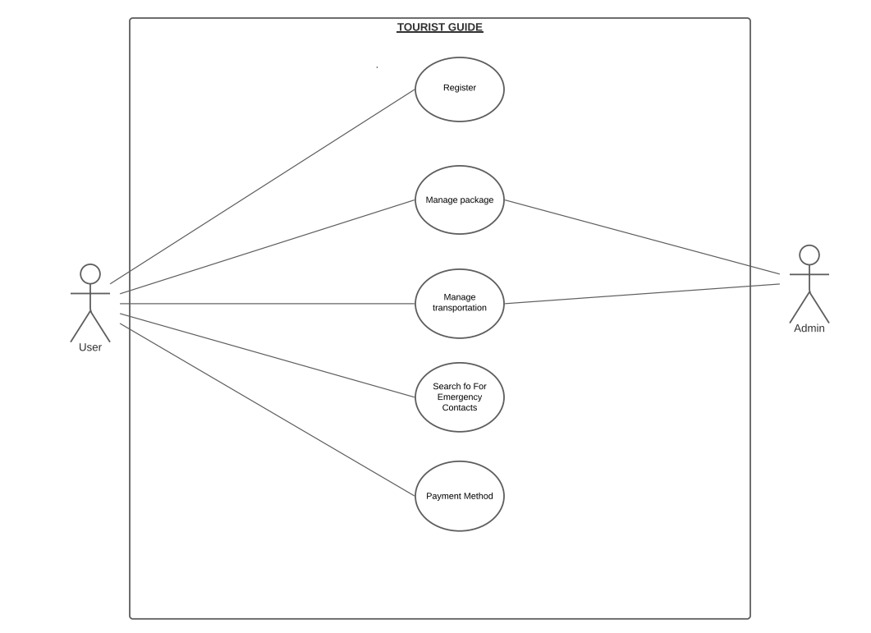
USE CASE DIAGRAM

Slide 8
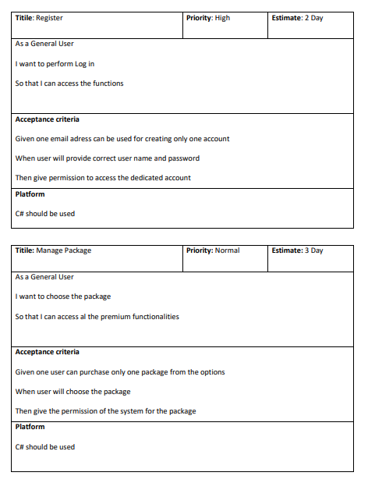
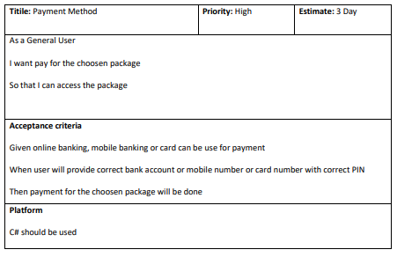
USER STORY TEMPLATE

Slide 9
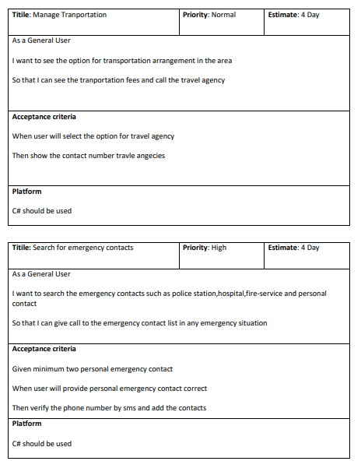
USER STORY TEMPLATE

Slide 10
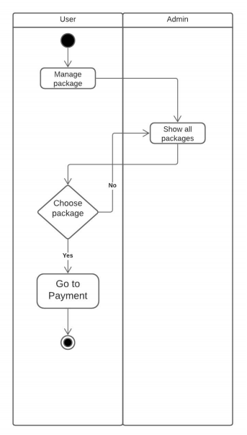
ACTIVITY DIAGRAM-1

Slide 11
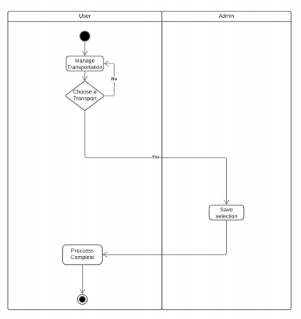
ACTIVITY DIAGRAM-2

Slide 12
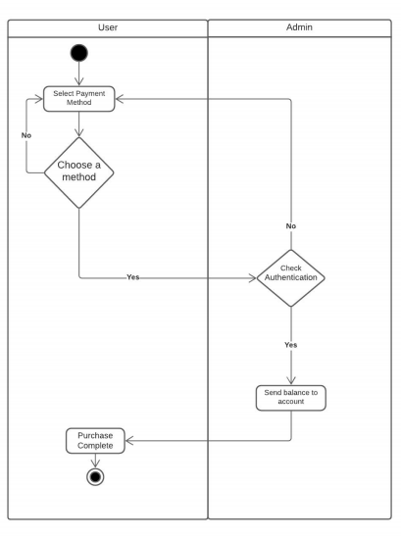
ACTIVITY DIAGRAM-3

Slide 13
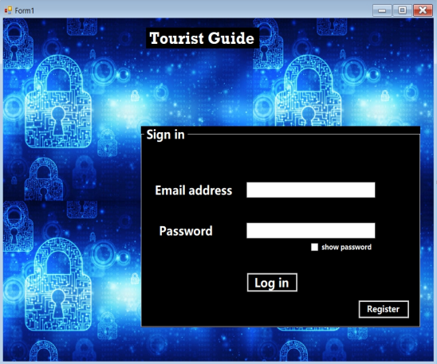
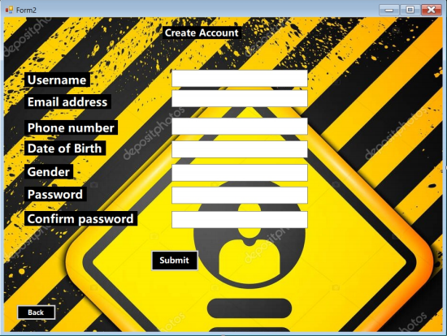
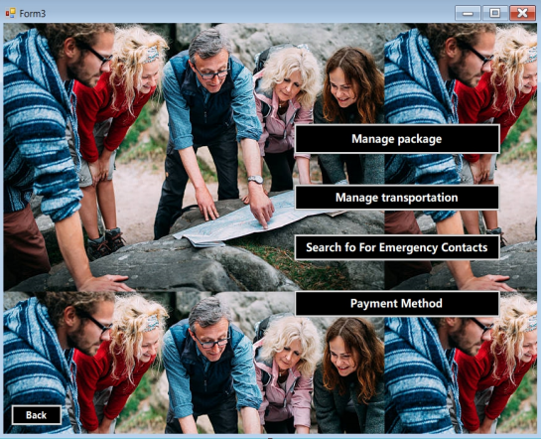
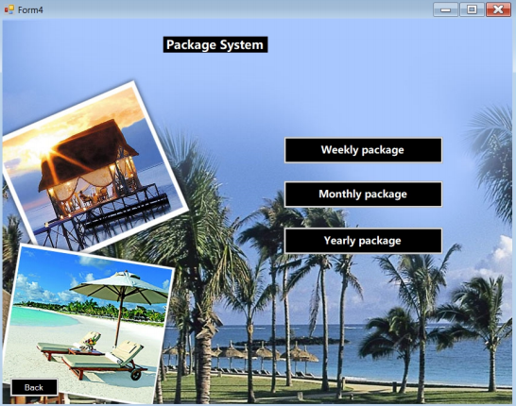
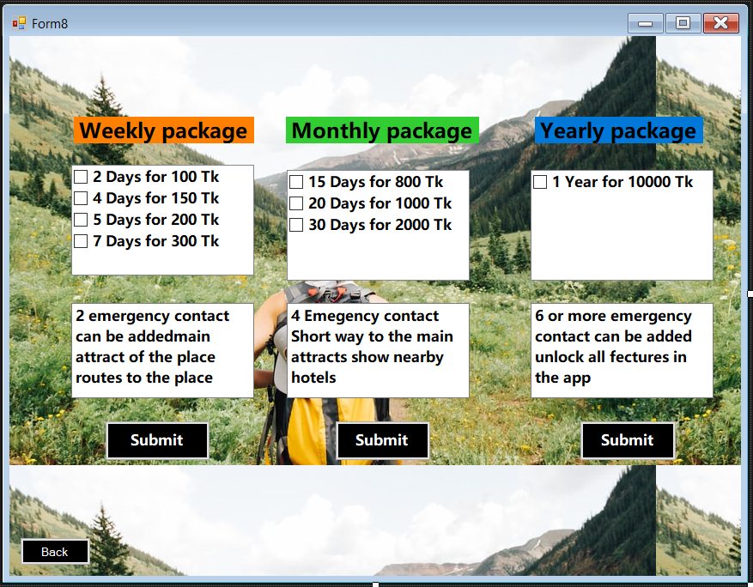
MOCK DESIGN

Slide 14
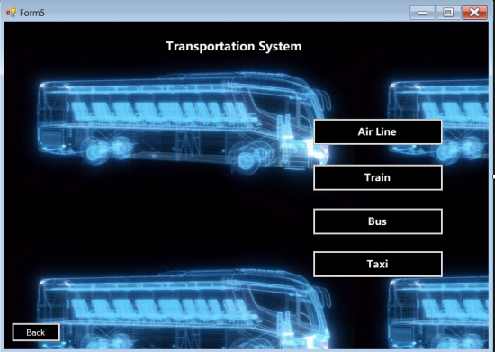
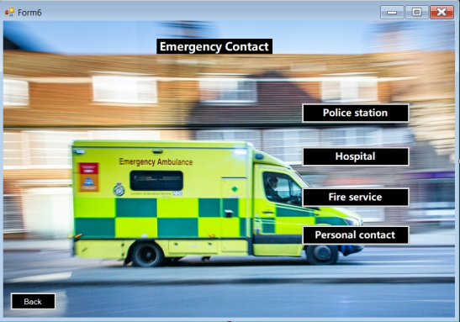
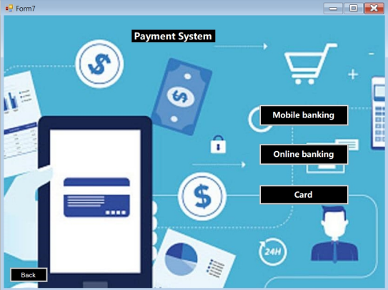
MOCK DESIGN

Slide 15
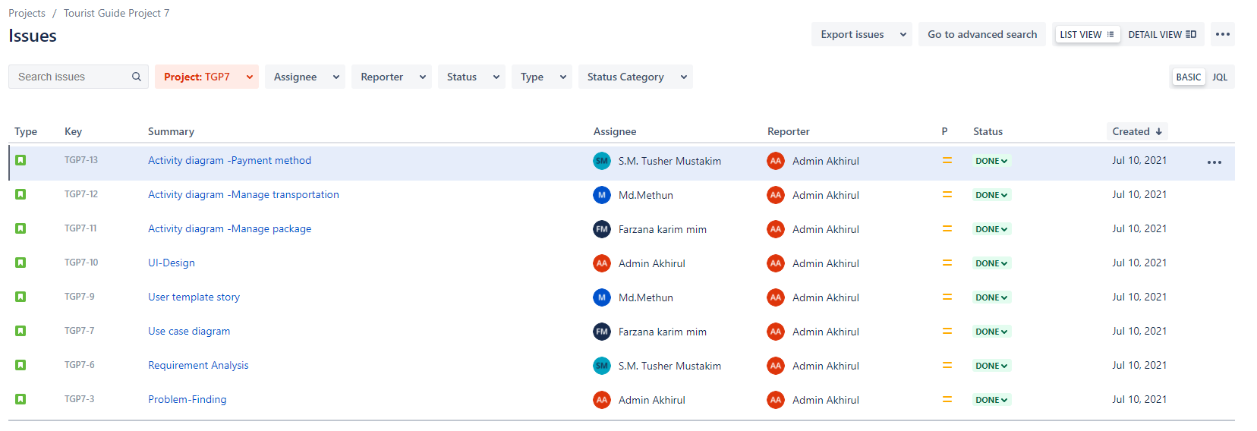
JIRA ISSUES

Slide 16
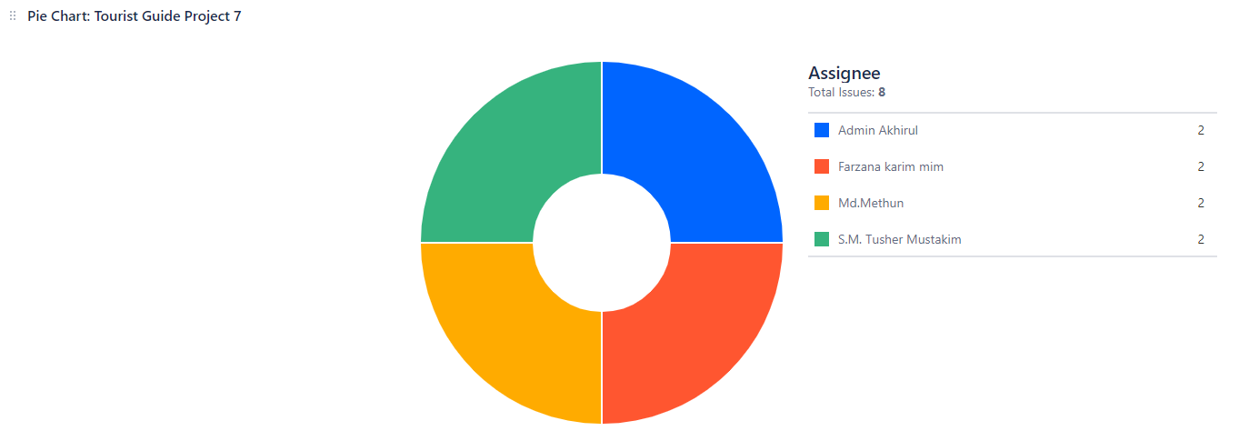
JIRA CONTRIBUTION PIE CHART

Slide 17
Git
Git init
Git status
Git add
Git commit
Git push
Git fetch
Git pull
Git clone

Slide 18
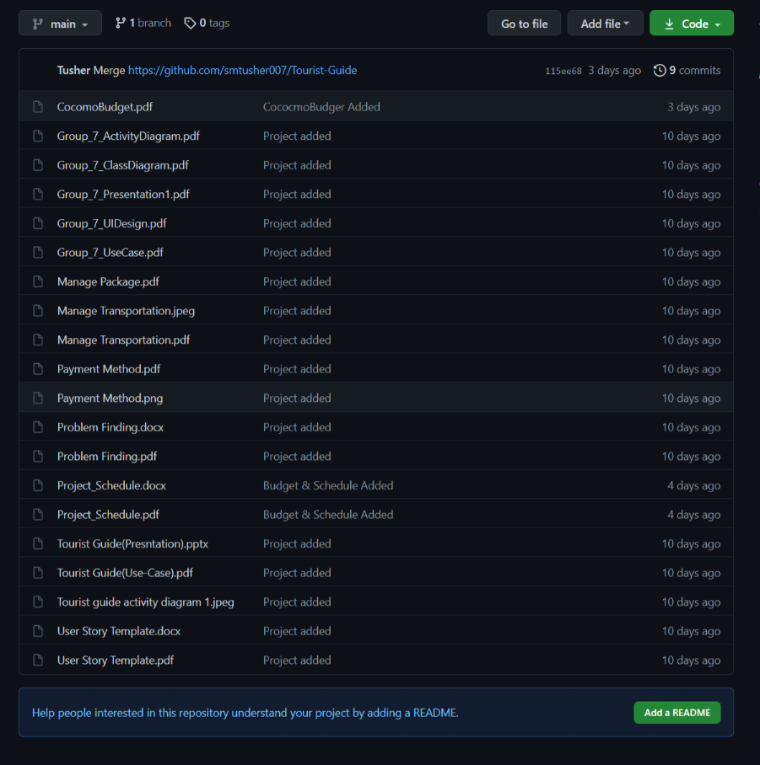
GitHub
Remote repository

Slide 19
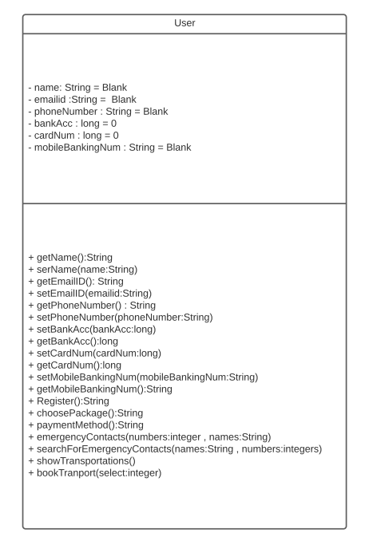
CLASS DIAGRAM-1

Slide 20
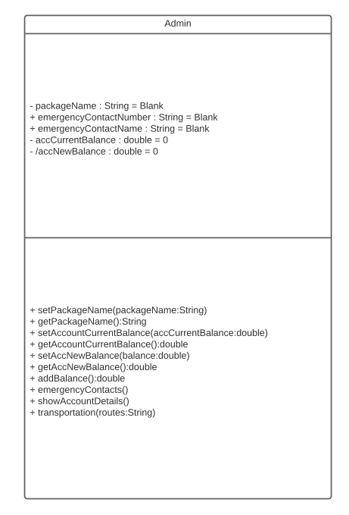
CLASS DIAGRAM-2

Slide 21
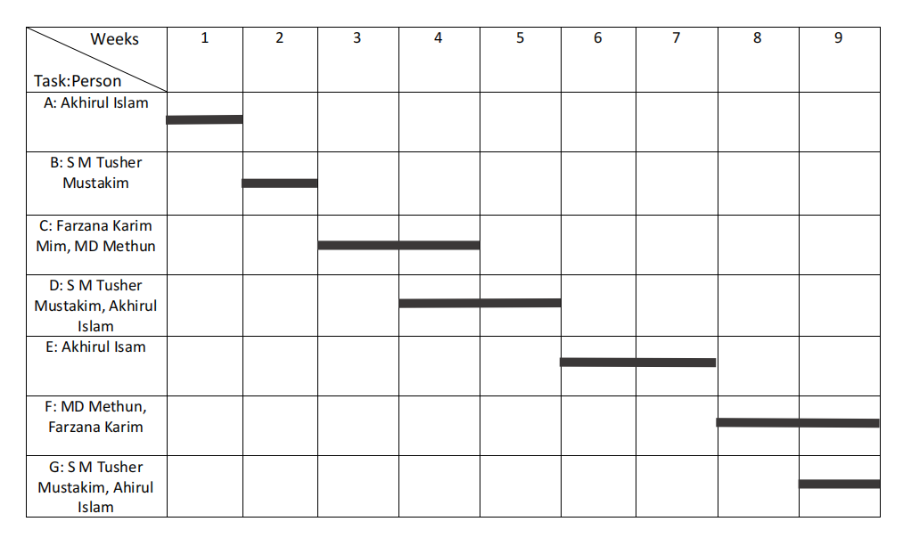
PROJECT SEHEDULING

Slide 22
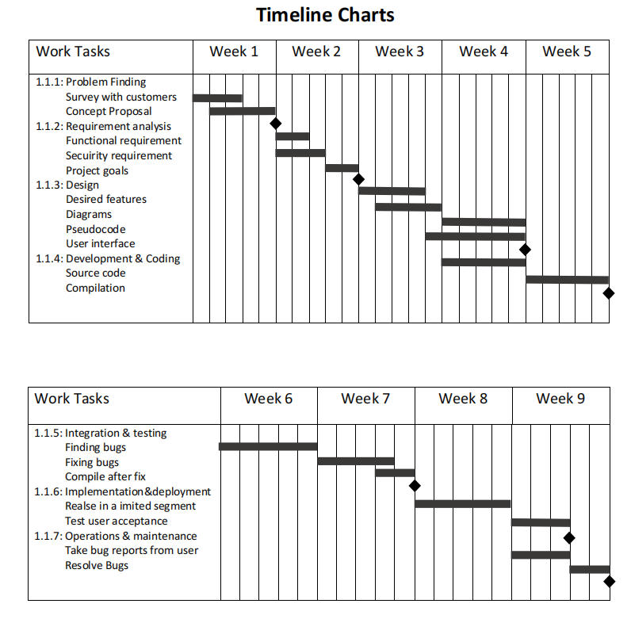
PROJECT SEHEDULING

Slide 23
CONSTRUCTIVE MODEL FOR TOURIST GUID SYSTEM:
Porject Type : Organic
Coefficient : 2.4[P=1.05; T=0.38]
SLOC (Source line of code) : 5000 Lines
Person Months, PM : (2.4*(5000/1000)1.05) =13.005
Development Time, DM : (2.5*13.0050.38) =6.626 =7Months =1232 Working Hour
Required People, ST : PM/DM= 1.85 = 2 People

Slide 24
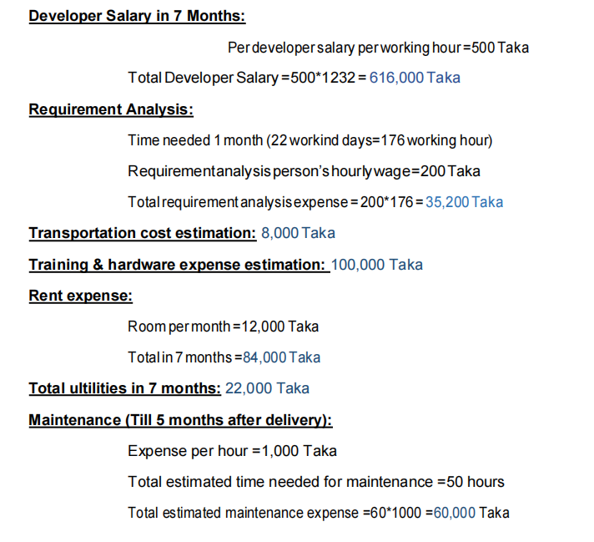
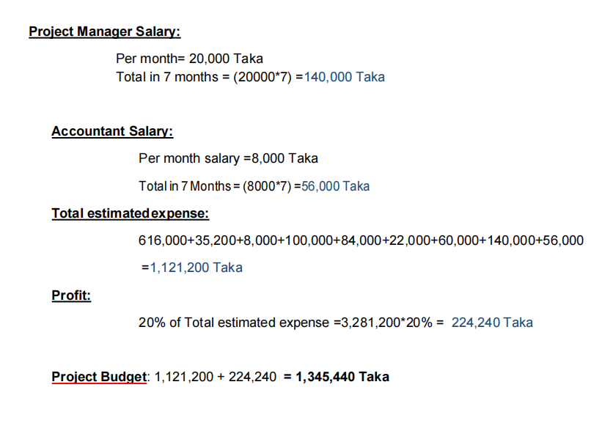
BUDGETING

Slide 25
CONCLUSION
Easy functionality
User Friendly UI design
Team work in different platform
Project management
Efficient project schedule
Moderate budgeting

Slide 26


